Slide 1
GOLD PRICE FORECASTING
(Group 4)
Ms Rutuja Nivrutti Khairnar
Mr. Sunnyraj Dadaji Aher
MR.MADAN K
Ms. Ankita Karamchand Loya
Mentor : Iftekar patel & Monica

Slide 2
Business Problem
Objective:
Data provided is related to gold prices. The objective is to understand the underlying structure in your dataset and come up with a suitable forecasting model which can effectively forecast gold prices for next 30 days or even more.
Gold has always been as attractive investment option for investor worldwide ,owing to its historical significance , stability , and hedge against inflation . gold prices are volatile and are subject to numerous macroecinomic and geopolitical factors, including interest rates, currency fluctuations , global trade market , and political stability. Hence predicting gold price accurately is a challenging task.
Goal of a Project
In this machine learning project, we aim to forecast gold prices for the next few months using historical gold price data from 2016 to 2021. We will use various time series analysis techniques, statistical models, and machine learning algorithms to predict future gold prices.
The project aims to develop a robust and accurate forecasting model that can be used by investors, traders, and other stakeholders to make informed investment decisions.
In this machine learning project, we aim to forecast gold prices for the next few months using historical gold price data from 2016 to 2021. We will use various time series analysis techniques, statistical models, and machine learning algorithms to predict future gold prices.
- The project aims to develop a robust and accurate forecasting model that can be used by investors, traders, and other stakeholders to make informed investment decis
In this machine learning project, we aim to forecast gold prices for the next few months using historical gold price data from 2016 to 2021. We will use various time series analysis techniques, statistical models, and machine learning algorithms to predict future gold prices.
- The project aims to develop a robust and accurate forecasting model that can be used by investors, traders, and other stakeholders to make informed investment decisions.
In this machine learning project, we aim to forecast gold prices for the next few months using historical gold price data from 2016 to 2021. We will use various time series analysis techniques, statistical models, and machine learning algorithms to predict future gold prices.
- The project aims to develop a robust and accurate forecasting model that can be used by investors, traders, and other stakeholders to make informed

Slide 3
Exploratory Data Analysis (EDA)
Data set details
Rows = 2182.
Columns = 2.
There is no null value in Dataset.
There is no Duplicate Value in Dataset.

Slide 4
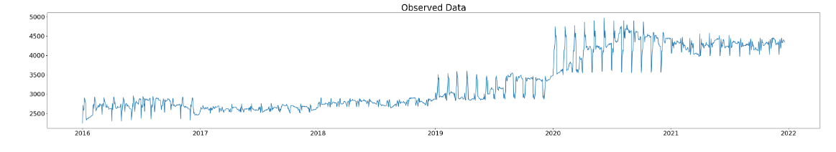
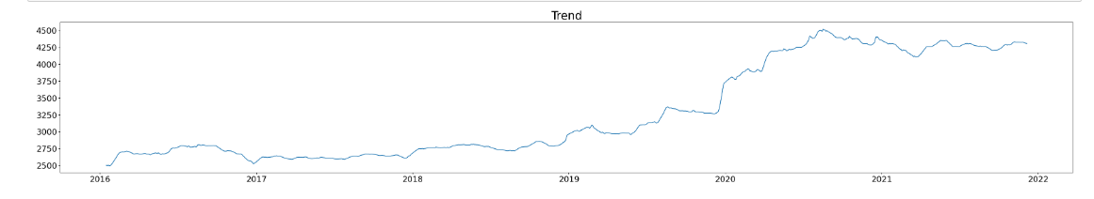
EDA (Visualization)
From bellow plot its shows the observed value of gold price from 2016 to 2021.
2.In this plot ,since the trend of the data from 2016 to 2019 is almost constant but changes from 2019 to 2021 ,it can be considered a changing trend specifically ,it would be an increasing trend from 2019 to 2021.

Slide 5
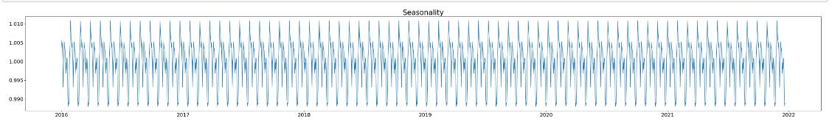
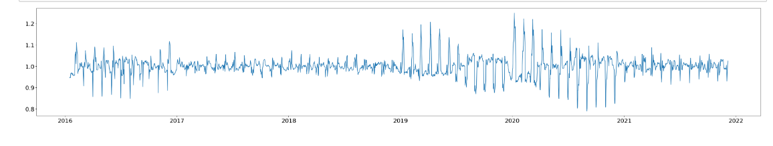
Plots for deep Visualization
.If the seasonal component is relatively constant in magnitude overtime, the data lightly seasonality.
1.If the residuals have more magnitude from 2019 to 2021 compared to previous years , it suggested that there might be some unexplained variability or noise in the data that the decomposition was not able to capture.
2. This could be due to external factors such as economic conditions or natural desature( Covid 19)that are not accounted for in the time series.

Slide 6
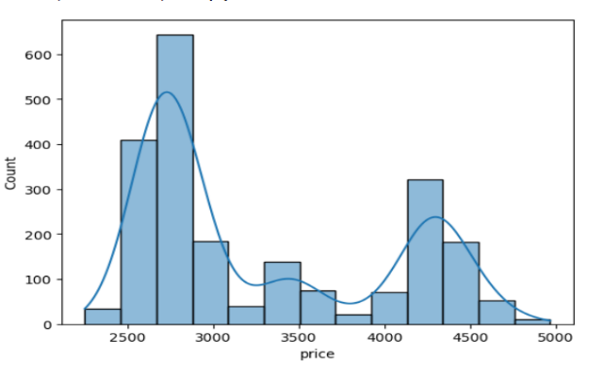
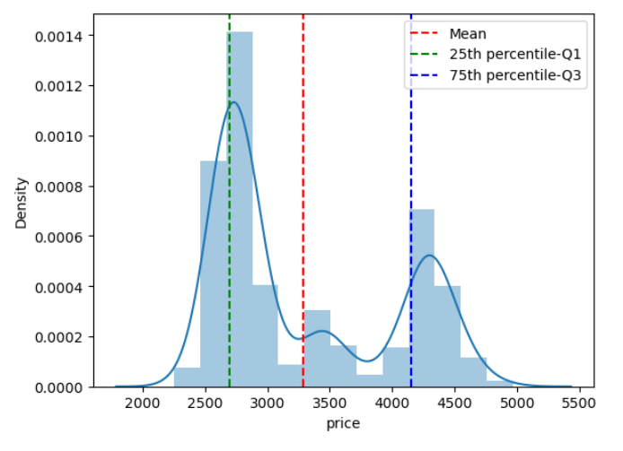
.The gold price values from 2600-2900 are most frequently occurred , the second most frequently occurred value are between 4100 to 4400.
.From this distribution plot we can see that data is rightly skewed.
. Also its binomial distribution.

Slide 7
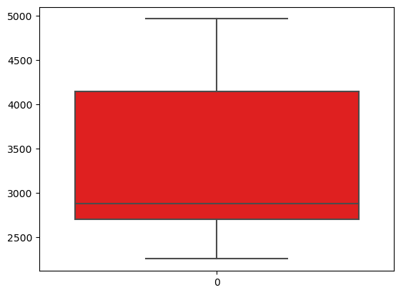
Boxplot

Slide 8
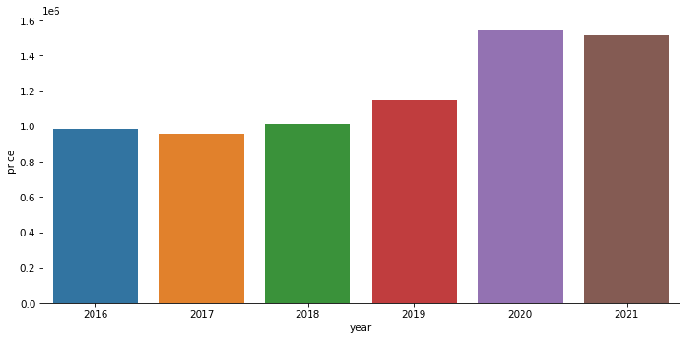
Let visualizing the sum of all sales each year. We can do that using group of “Price” and “Date” and group by “Year”.
We can see that by catplot the price increased in year 2020 & 2021

Slide 9
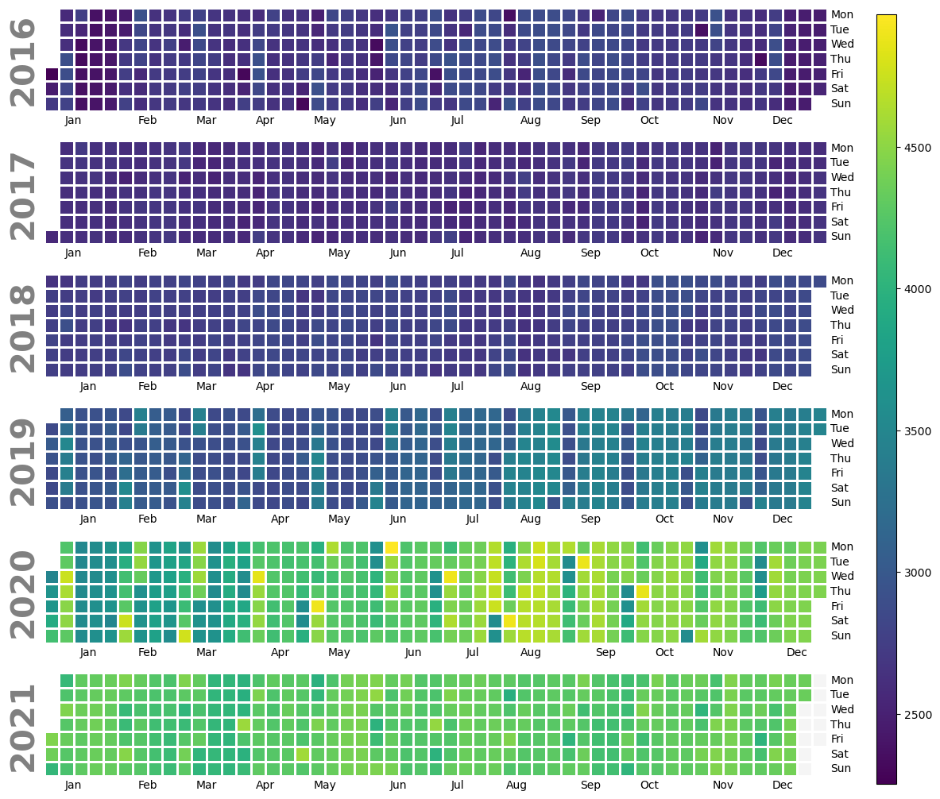
Calplot
From above plot we can conclude the gold prices are increasing 2016 to 2020.
In year 2020 the gold prices are very high , but in year 2021 the gold prices has decreased to some extent

Slide 10
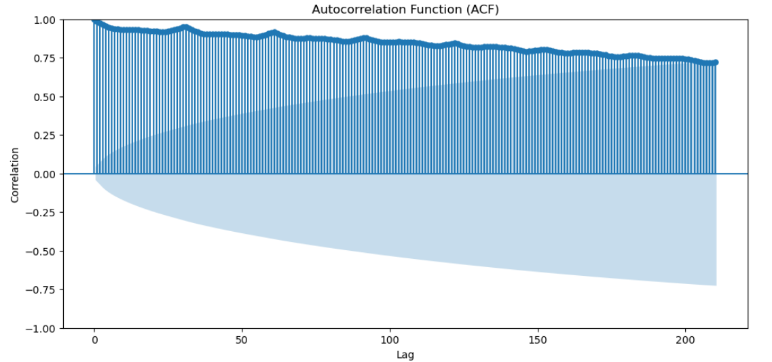
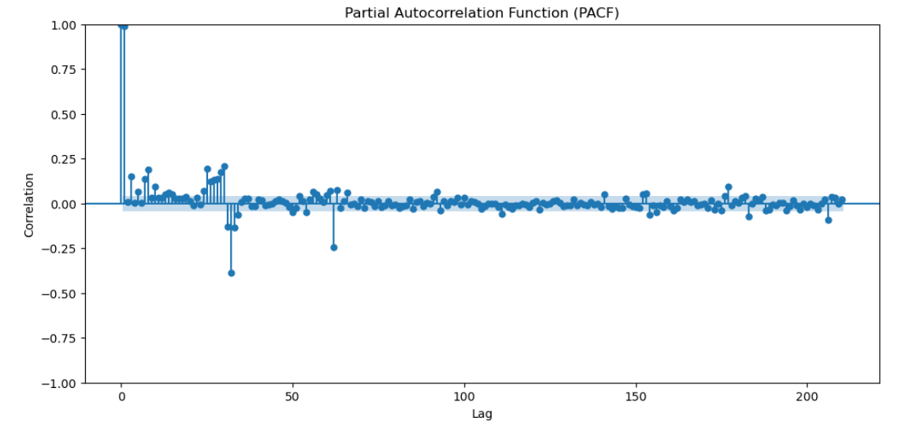
ACF & PACF plots.
.From the above for ACF plot we can see that the lines are above the standard error which explain the lags k=210 are positively correlated with current observation and after that drop of takes place so we can predict the price at least for 7 months with some amount of accuracy.
. In PACF plot it explains the direct effect of the lags with current observation ,after first lag we can see some lags are getting drop off in standrad error and further some are above and below the standrad error.
.In your case , if the ACF Plot show that’s significant lags drop off after k=210 , then a good starting point for the MA order would be Q=210 & if the PACF plot show that significant lag drop off after some point , then good starting point for the AR order would be P=1 that point.
.ACF measures direct & indirect effect of all lags on the current observation while PACF measures only direct effect of particular lags on the current observation.

Slide 11
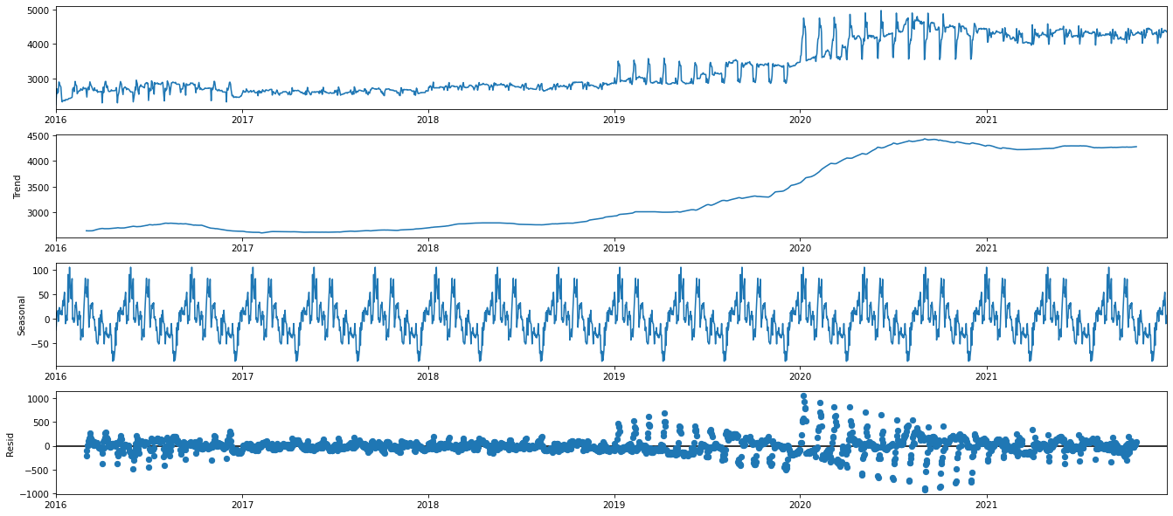
Time series decomposition
Trend - Slow moving changes in a time series, Responsible for making series gradually increase or decrease over time.
Seasonality - Seasonal Patterns in the series. The cycles occur repeatedly over a fixed period of time.
Residuals - The behavior of the time series that cannot be explained by the trend and seasonality components. Also called random errors/white noise.

Slide 12
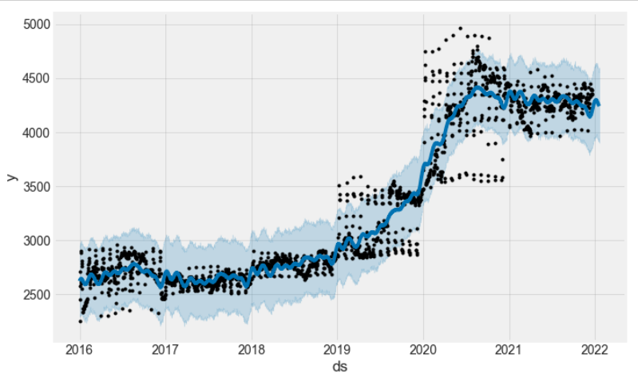
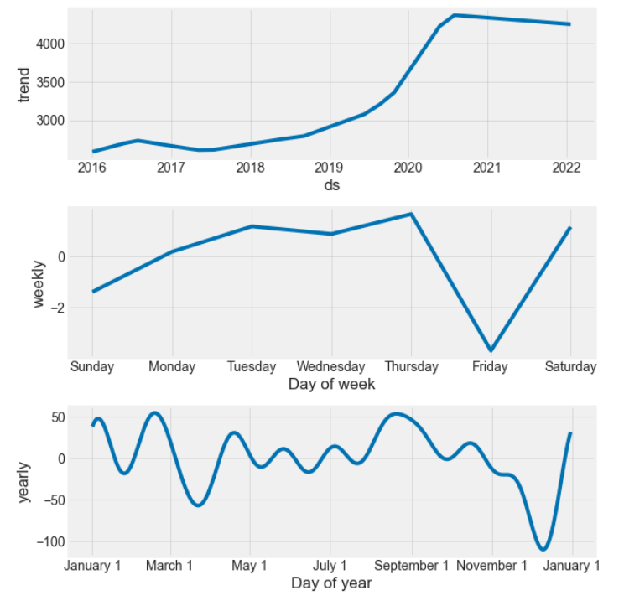
Visualizing changes in mean over 365 days
From the above plot, we can see that there is no constant direction of the mean (increase/decrease) which is understandable as there might be many external factors involved in price fluctuation.

Slide 13
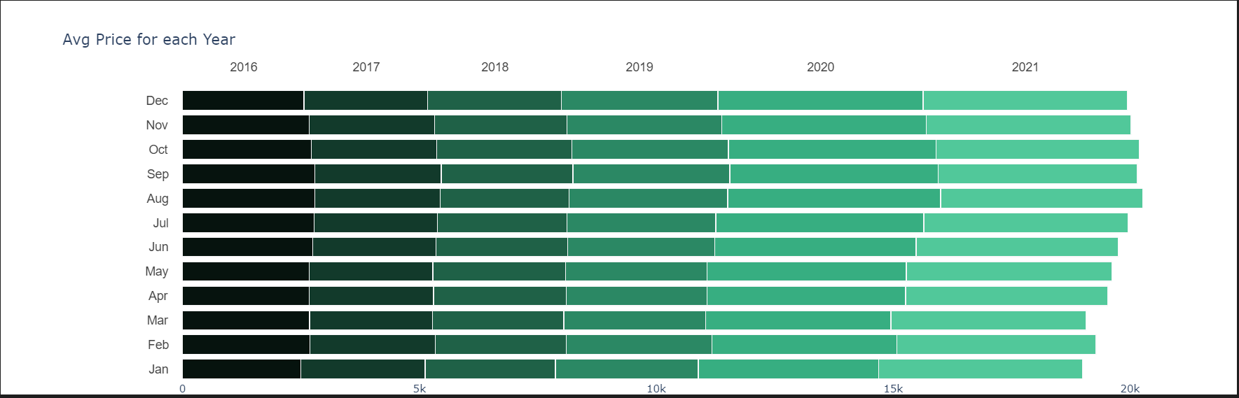
Feature Engineering
Average price of gold for each year
Observation:
* Highest prices of gold are in August to December and the decreased in January to March
* Price are increasing gradually from 2019 to 2021

Slide 14
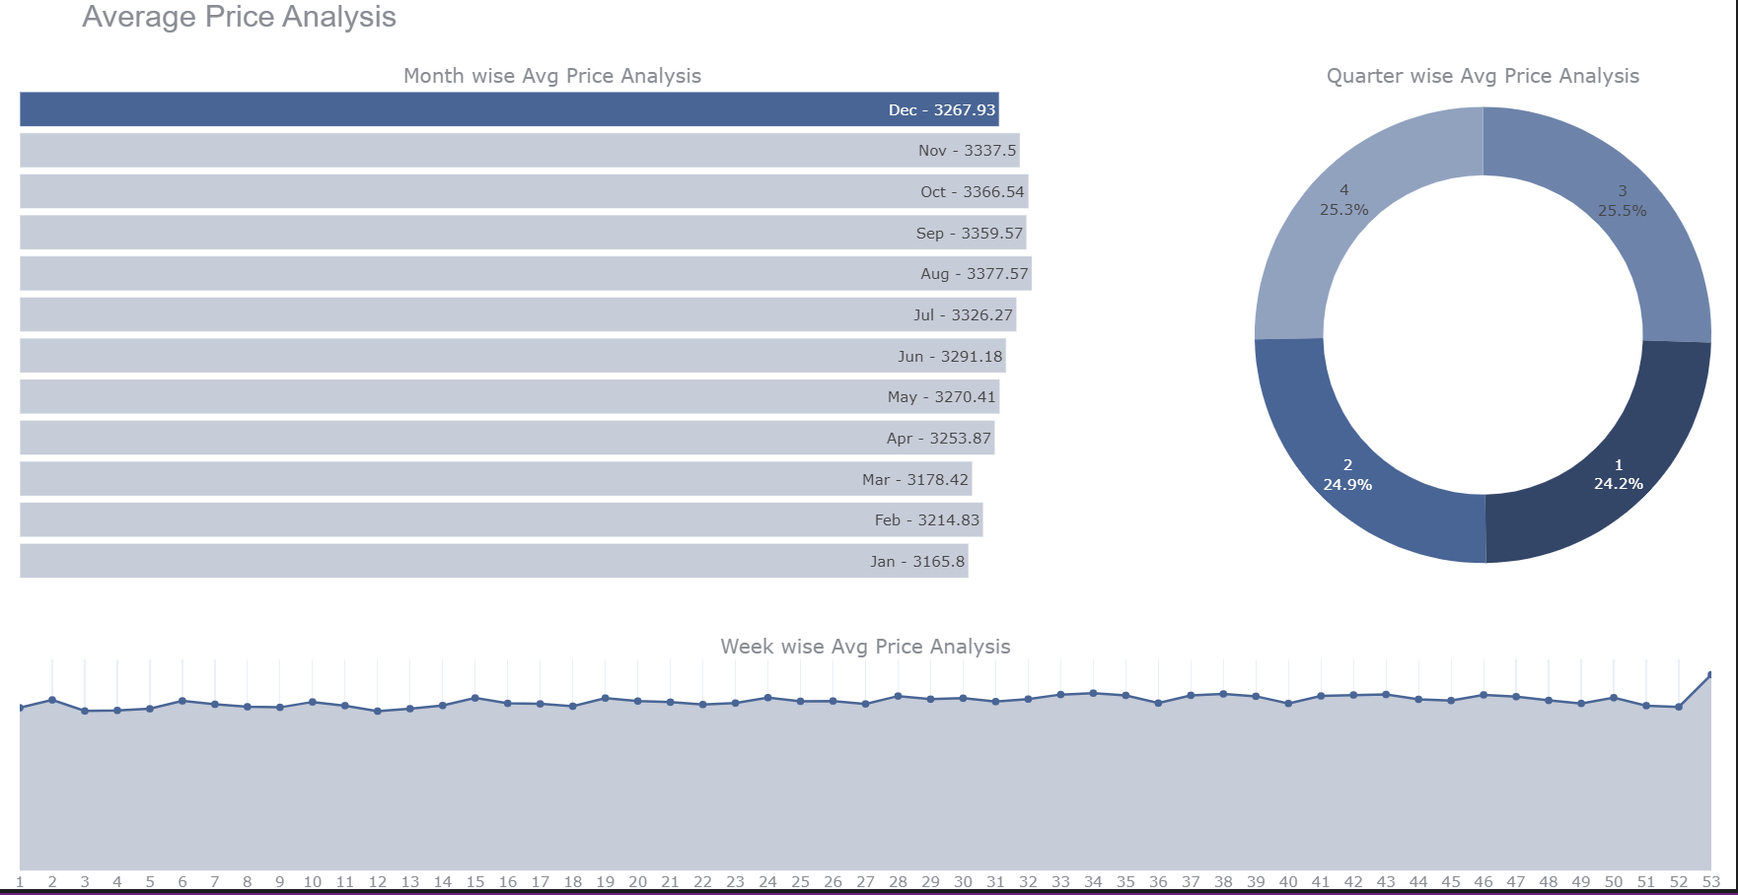
Charts for visualize the Month, Quarter and week wise prices of Gold

Slide 15
Augmented Dickey-Fuller Test
Augmented Dickey-Fuller Test
The intuition behind the test is that if the series is integrated then the lagged level of the series y(t-1) will provide no relevant information in predicting the change in y(t).
Null hypothesis: The time series is not stationary
Rejecting the null hypothesis (i.e. a very low p-value) will indicate stationarity
Results of Dickey-Fuller Test:
Test Statistic -4.795076
p-value 0.000056
#Lags Used 26.000000
Number of Observations Used 2066.000000
Critical Value (1%) -3.433519
Critical Value (5%) -2.862940
Critical Value (10%) -2.567515

Slide 16
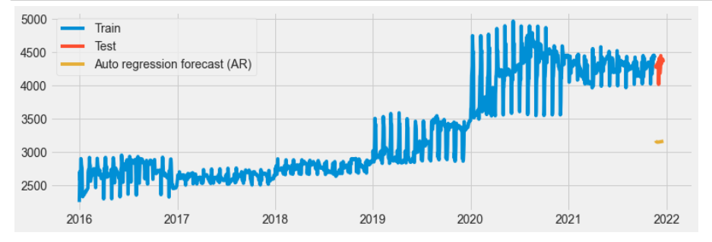
ARIMA model

Slide 17
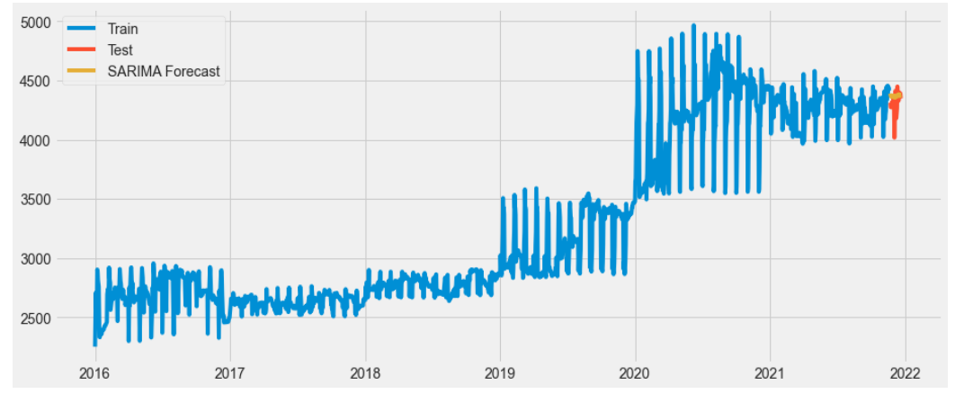
SARIMAX Model

Slide 18
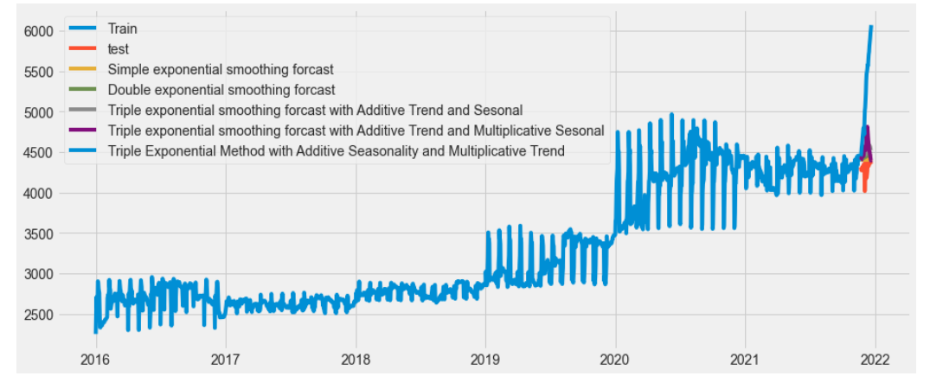
Exponential smoothing model
- 1.It captures the trend, which we can see that the forecasted values are higher level than the test level
2.It also captures the seasonality.
- 3.The peak of the forecasted value is higher than the actual.

Slide 19
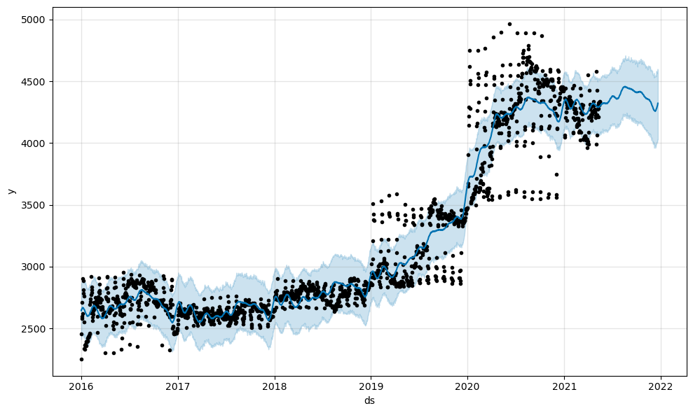
FB Prophet

Slide 20
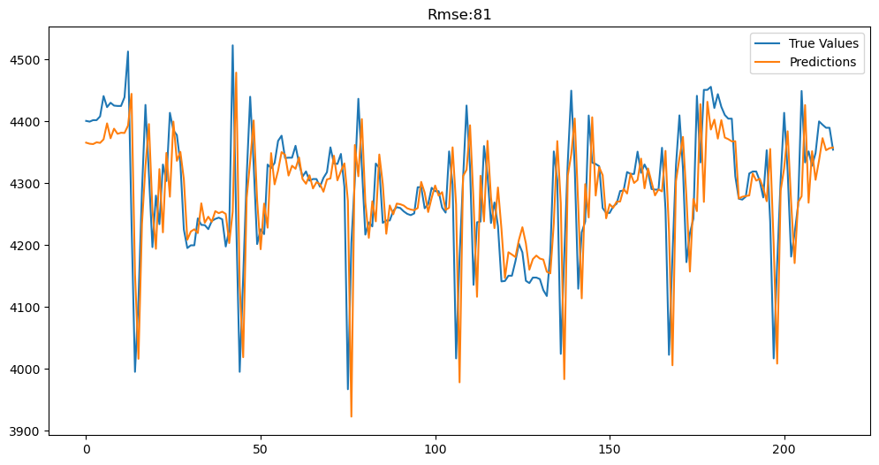
Lstm Model

Slide 21
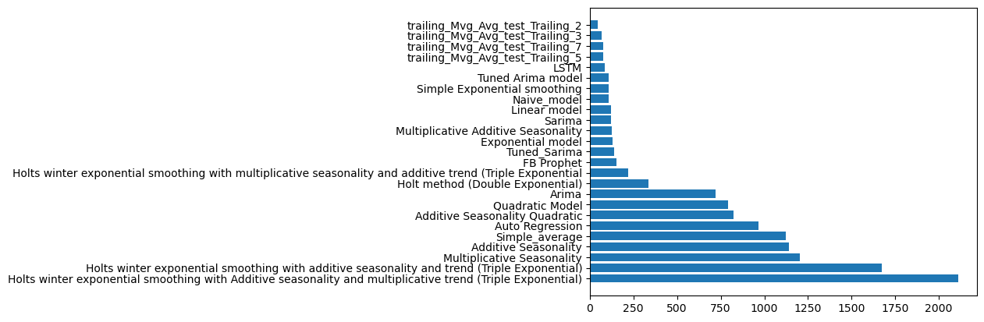
Summary

Slide 22
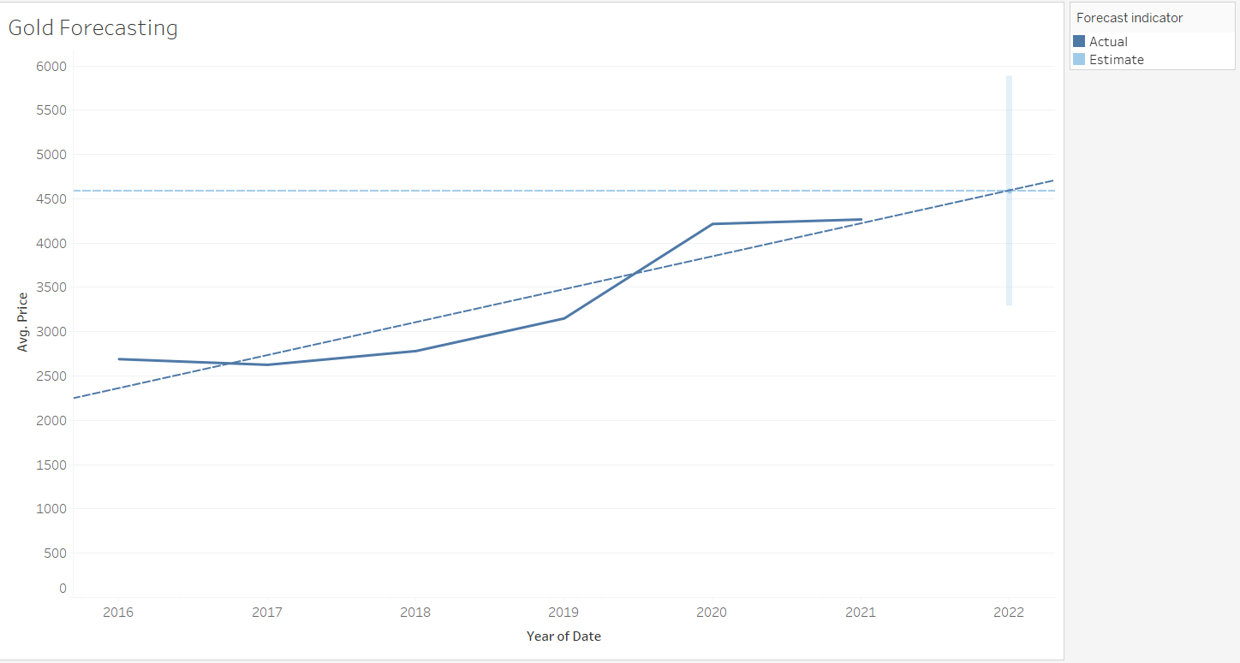
Tableau

Slide 23
Time series: Year of Date
Measures: Avg. Price
Forecast forward: 1 year (2022)
Forecast based on: 2016 - 2021
Ignore last: No periods ignored
Seasonal pattern: 1 year cycle
Avg. Price
Initial Change From Initial Seasonal Effect Contribution
2022 2022 High Low Trend Season Quality
4,587 ± 1,298 0 2022 1 2022 1 0.0% 0.0% Poor
RMSE | MAE | MASE | MAPE | AIC
487 | 411 | 1.21 | 12.8% | 86

Slide 24
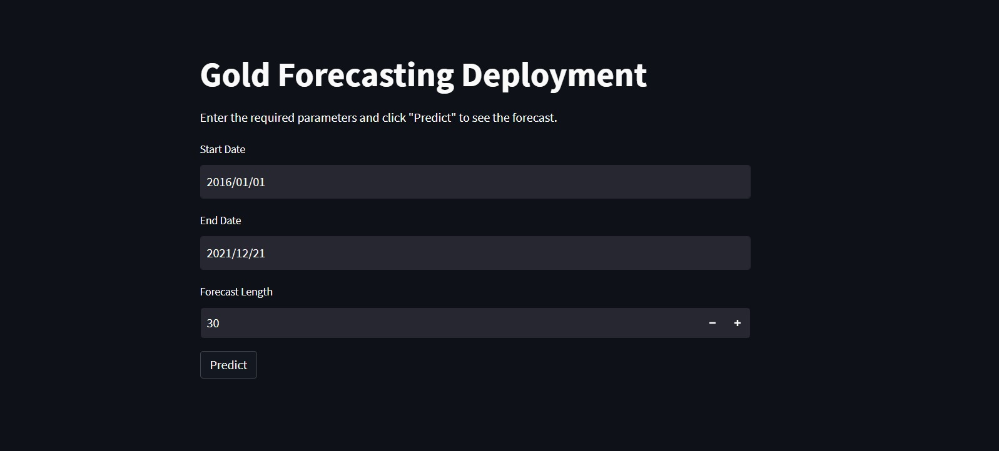
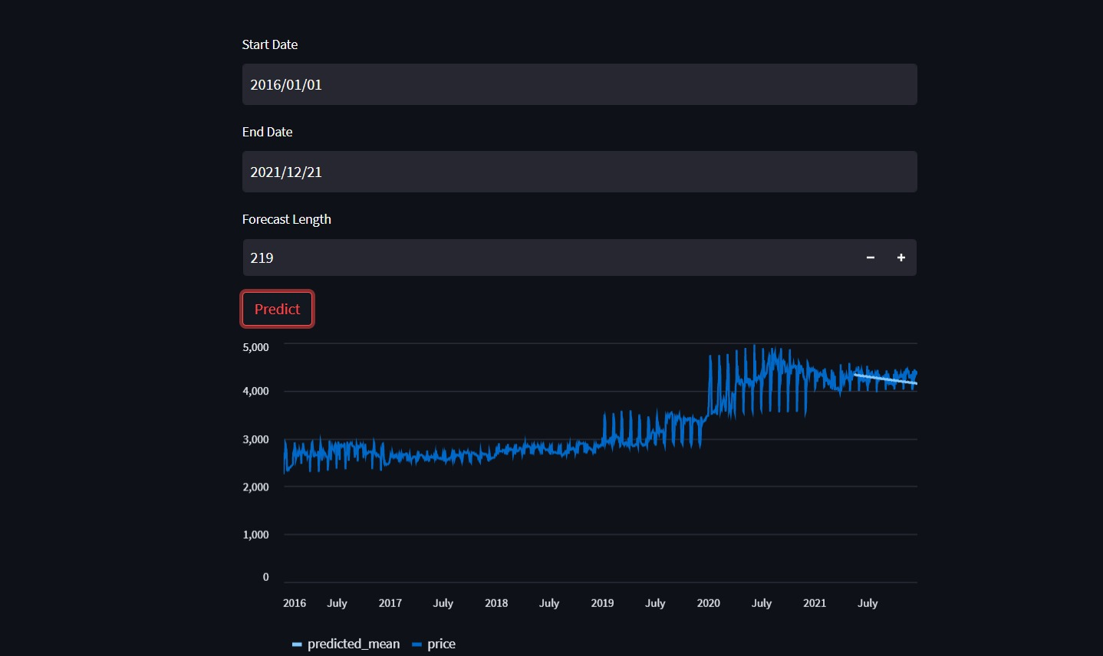
Sarima Model Deployment

Slide 25
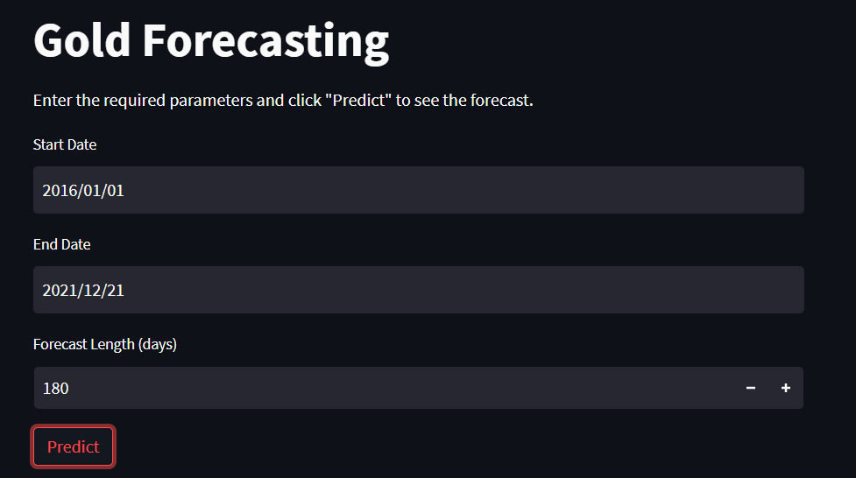
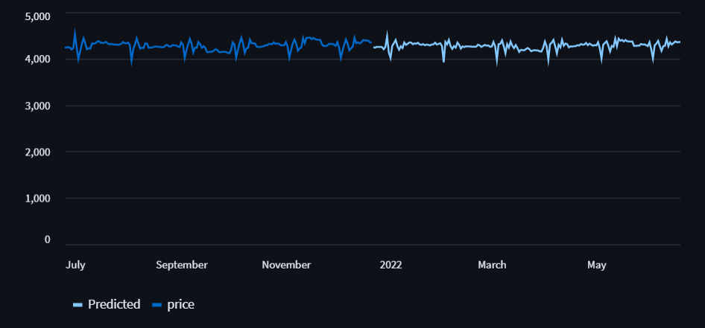
LSTM Model Deployment

Slide 26
Challenges Faced while working on project:
While working on the project we encountered error during cross checking the stationary of data
We had build various model based and data driven models so we took more time for model building part and come to conclusive model for the Deployment
While building model building and implementation phase we encounted errors.
we overcome this challenges by interacting with the team mates and taking their insights, also collecting information from few online sources.

Slide 27
Thank You

